Slide 1
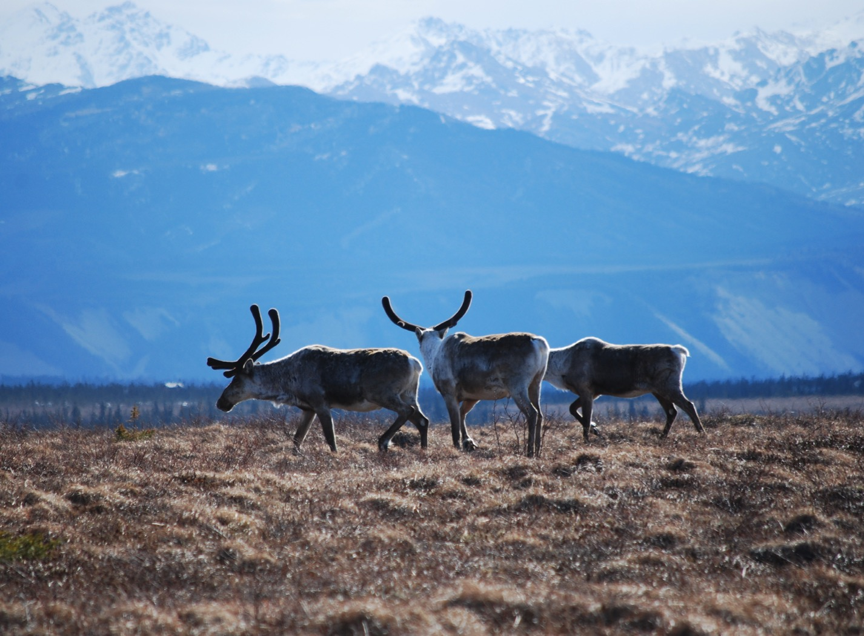
Arctic Boreal Vulnerability Experiment (ABoVE)
2017 ABoVE Airborne Campaign
7 July 2017 (DOY 188)
AVIRIS-NG: Yukon-Kuskokwim Delta
Charles Miller, Deputy Science Lead
Jet Propulsion Laboratory, California Institute of Technology
and the ABoVE Science Team
For Hank Margolis, Eric Kasichke, Bruce Tagg
NASA HQ
2017

Slide 2

7 July 2017/DOY 188
Yukon-Kuskokwim Delta
Daily Status:
AVIRIS-NG / Dynamic Aviation B-200 (N53W)
REPORT DATE: 7 July 2017
Current Status of Aircraft: Yellow
Current Status of AVIRIS: GREEN
Current Deployment Location: Fairbanks AK (PAFA)
Crew: Rogers, Heidt, Nolte, Bernas
Science Coordinator: A Thorpe
Science Lead: C Miller
Project Managers: M Eastwood, I McCubbin
Instrument PI: R Green
Notes:
Aircraft avionics package continues to have intermittent loss of heading problems

Slide 3
7 July 2017/DOY 188
72-Hour Look Ahead
All plans weather dependent
Saturday 8 July 2017 (DOY 189):
Fort Yukon
Sunday 9 July 2017 (DOY 190):
Barrow/North Slope
Monday 10 July 2017 (DOY 191):
Down Day

Slide 4
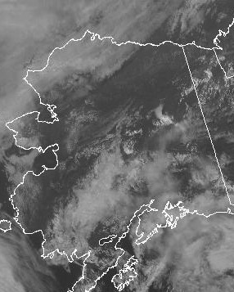
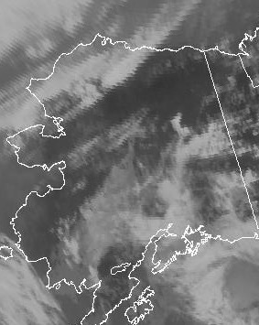
7 July 2017/DOY 188
Yukon-Kuskokwim Delta
GOES-West Vis 2200Z
GOES-West IR 2200Z
Notes:
Visible and IR channels suggest mostly clear conditions near Emmonak and Chevak on the YK Delta, although closer inspection of the visible image does indicate coastal low clouds

Slide 5
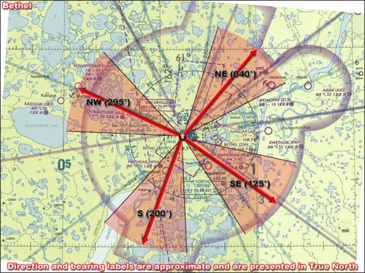
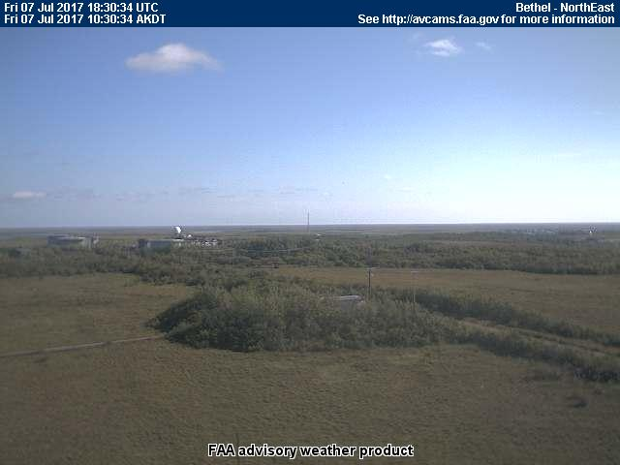
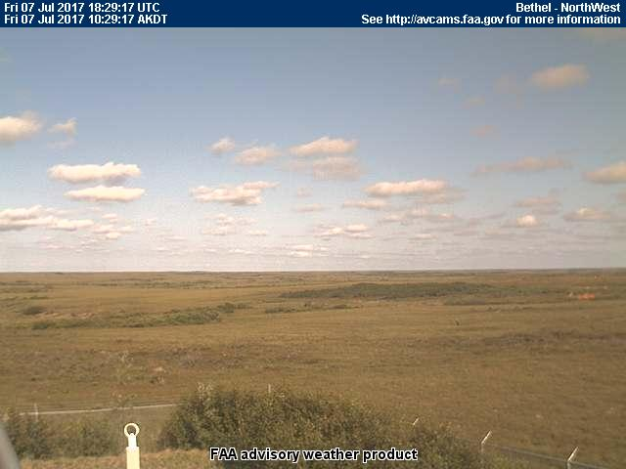
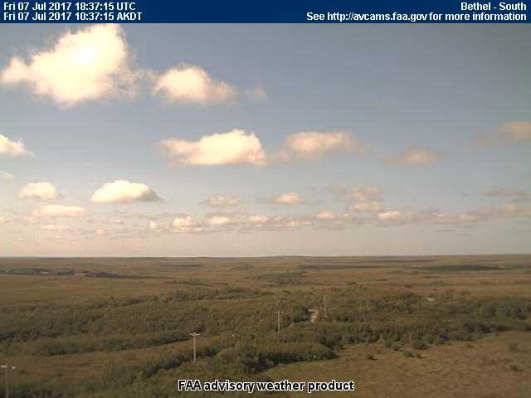
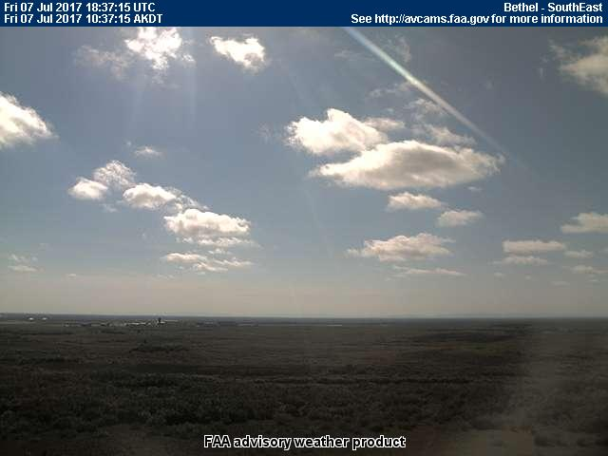
7 July 2017/DOY 188
Yukon-Kuskokwim Delta
Bethel (BET)
NORTH
Northeast
Northwest
South
Southeast
Notes:
AVCAM sky pictures from Bethel clear to show partly cloudy conditions
See http://avcams.faa.gov/ for an interactive map of Alaska aviation cameras

Slide 6
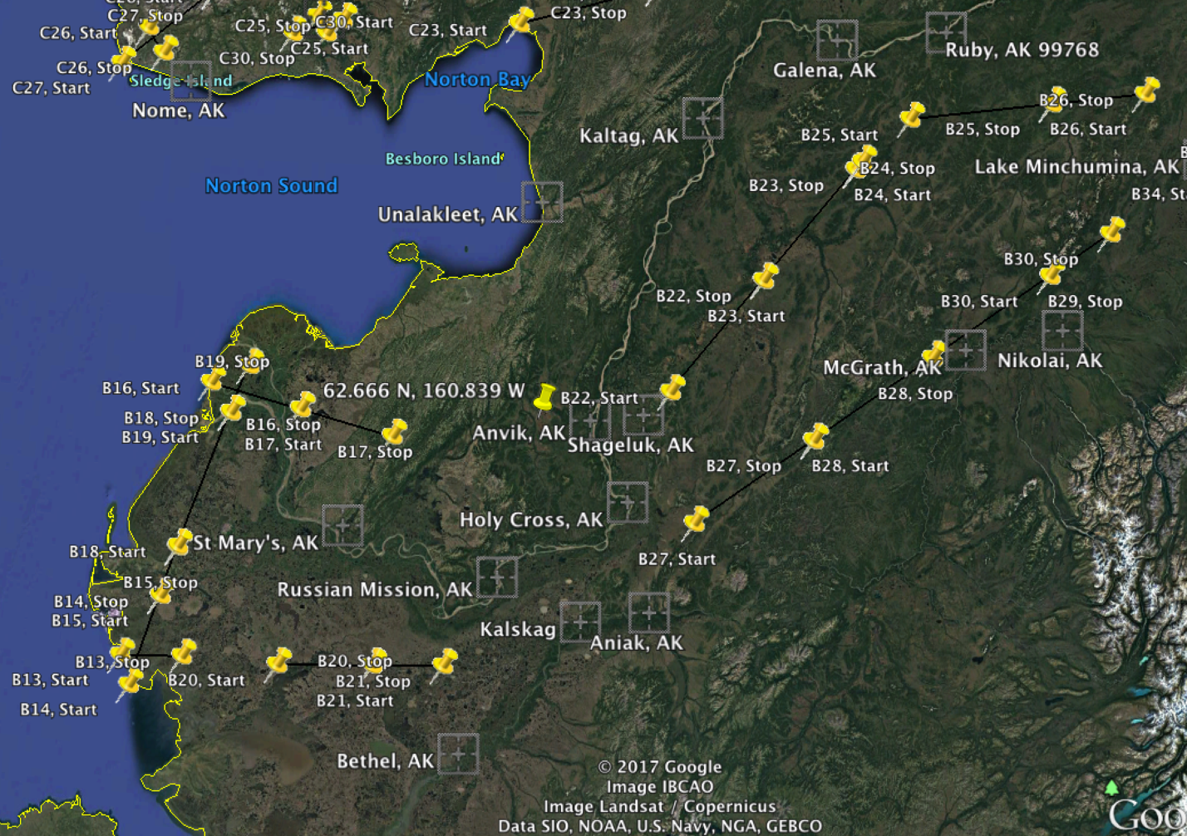
7 July 2017/DOY 188
Yukon-Kuskokwim Delta
Planned flight lines & acquisition segments

Slide 7
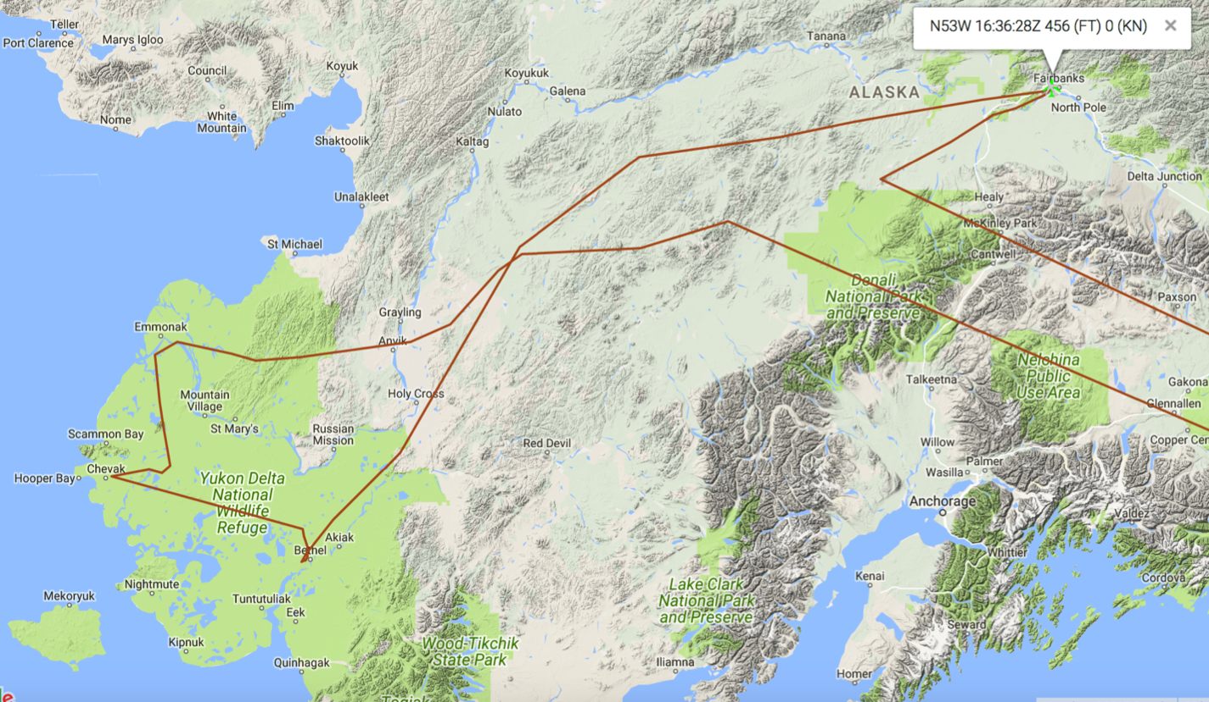
20 July 2017/DOY 201
Yukon-Kuskokwim Delta
As-flown flight lines & acquisition segments
B25
B24
X
B23
Bonus
X
B22
B17
Bonus
Bonus
B14
B13
B20
B21
Notes:
Glitches in the NASA Airborne Tracker produced spurious flight lines marked with red Xs

Slide 8
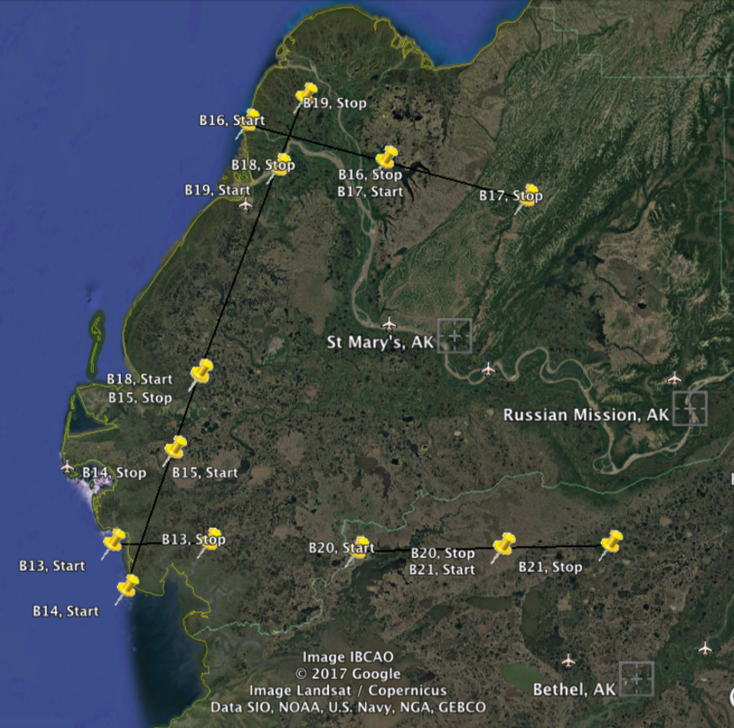
7 July 2017/DOY 188
Yukon-Kuskokwim Delta
Planned flight lines
YK Delta
3
2
Data Acquisitions:
Line 1, B17, Track Air #95
Line 2, B16, Track Air #94
Line 3, B19, Track Air #97
Line 4, B18, Track Air #96
Line 5, B15, Track Air #93
Line 6, B14, Track Air #94
Line 7, B13, Track Air #91
Line 8, B20, Track Air #98
Line 9, B21, Track Air #99
1
4
5
6
7
8
9
Notes:
Line 9, B20 successfully acquired on 7/7/17

Slide 9
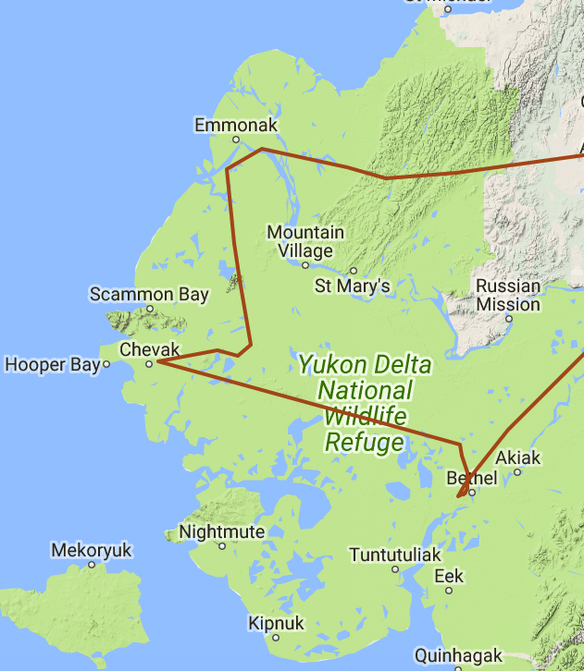
7 July 2017/DOY 188
Yukon-Kuskokwim Delta
As-flown Lines: Sortie #1
Planned Lines:
Sortie #1
3
3
2
2
1
1
4
4
5
6
7
5
8
9
6
7
8
9
Notes:
Red numbers: Lines #2-5 not flown due to excessive cloud interference – operator discretion

Slide 10
7 July 2017/DOY 188
Yukon-Kuskokwim Delta
AVIRIS-NG Quick-look products
https://avirisng.jpl.nasa.gov/cgi/flights.cgi?step=view_flightlog&flight_id=ang20170707t
A. Bonus Line, Run ID 182443: Start 63.456 N, 156.458 W east of Innoko NWR
B. Bonus Line, Run ID 190303: Start 62.666 N, 160.839 W due west of Anvik
Winston Olson-Duvall, JPL
A
B
A. Imaging of the hills on the eastern boundary of the Innoko NWR
B. Coastal mountains separating Anvik from St Mary’s

Slide 11
7 July 2017/DOY 188
Yukon-Kuskokwim Delta
AVIRIS-NG Quick-look products
https://avirisng.jpl.nasa.gov/cgi/flights.cgi?step=view_flightlog&flight_id=ang20170707t
A. Line B17, Track Air #95, Run ID 191547: Mouth of Yukon R - inland transect - cont of B16
B. Line B16, Track Air #94, Run ID xxx: Mouth of Yukon R - inland transect
Winston Olson-Duvall, JPL
A
B
B16 Not Acquired
Emmonak
A. Inland acquisition east of Emmonak
B. B16 not acquired – excessive cloud interference – operator discretion

Slide 12
7 July 2017/DOY 188
Yukon-Kuskokwim Delta
AVIRIS-NG Quick-look products
https://avirisng.jpl.nasa.gov/cgi/flights.cgi?step=view_flightlog&flight_id=ang20170707t
A. Line B19, Track Air #97, Run ID xxx: YK Delta transect - continuation of B18
B. Line B18, Track Air #96, Run ID xxx: YK Delta transect - continuation of B15
Winston Olson-Duvall, JPL
A
B19 Not Acquired
B
B18 Not Acquired
A. B19 not acquired – excessive cloud interference – operator discretion
B. B18 not acquired – excessive cloud interference – operator discretion

Slide 13
7 July 2017/DOY 188
Yukon-Kuskokwim Delta
AVIRIS-NG Quick-look products
https://avirisng.jpl.nasa.gov/cgi/flights.cgi?step=view_flightlog&flight_id=ang20170707t
A. Line B14, Track Air #92, Run ID 200100: Frost - YK Delta parallel coast
B. Line B13, Track Air #91, Run ID 201715: Frost - YK Delta coast - inland transect
Winston Olson-Duvall, JPL
A
B
A & B. >50% cloud cover obscures scenes in lines B14 and B13

Slide 14
7 July 2017/DOY 188
Yukon-Kuskokwim Delta
AVIRIS-NG Quick-look products
https://avirisng.jpl.nasa.gov/cgi/flights.cgi?step=view_flightlog&flight_id=ang20170707t
A. Line B20, Track Air #98, Run ID 203340: Schaefer - YK Delta lakes
B. Line B21, Track Air #99, Run ID 204858: Schaefer - YK Delta lakes – cont of B20
Winston Olson-Duvall, JPL
A
B
A. ~20% cloud cover across line B20
B. Intense greenness interspersed with markedly less productive (drier?) wetlands
Notes:
Clear scene in Line B21 consistent with the mostly clear skies observed in the Bethel AVCAM

Slide 15
7 July 2017/DOY 188
Yukon-Kuskokwim Delta
AVIRIS-NG Quick-look products
https://avirisng.jpl.nasa.gov/cgi/flights.cgi?step=view_flightlog&flight_id=ang20170707t
A. Line B22, Track Air #100, Run ID 183615: Southern Innoko NWR
B. Bonus Line, Run ID 230715: Start 62.000 N, 158.990 W
Winston Olson-Duvall, JPL
A
B
A. Southern end of Innoko NWR, line ends near Shageluk AK
B. Bonus Line starts in the hills south of Line B22

Slide 16
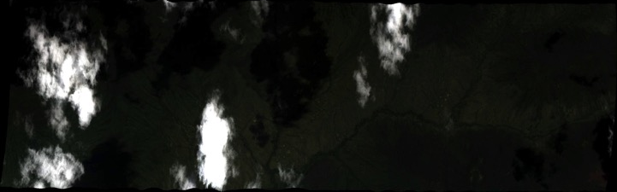
7 July 2017/DOY 188
Yukon-Kuskokwim Delta
AVIRIS-NG Quick-look products
https://avirisng.jpl.nasa.gov/cgi/flights.cgi?step=view_flightlog&flight_id=ang20170707t
A. Line B23, Track Air #101, Run ID 231429: Middle Innoko NWR
B. Line B24, Track Air #102, Run ID 233001: Northern Innoko NWR
Winston Olson-Duvall, JPL
A
B
A. A few clouds but otherwise good sample
B. Line was planned to be this short

Slide 17
7 July 2017/DOY 188
Yukon-Kuskokwim Delta
AVIRIS-NG Quick-look products
https://avirisng.jpl.nasa.gov/cgi/flights.cgi?step=view_flightlog&flight_id=ang20170707t
A. Line B25, Track Air #103, Run ID 233757: Schaefer tree ring sites south of Ruby AK
Winston Olson-Duvall, JPL
A
A. Approx 50% cloud covered

Slide 18
Backup

Slide 19
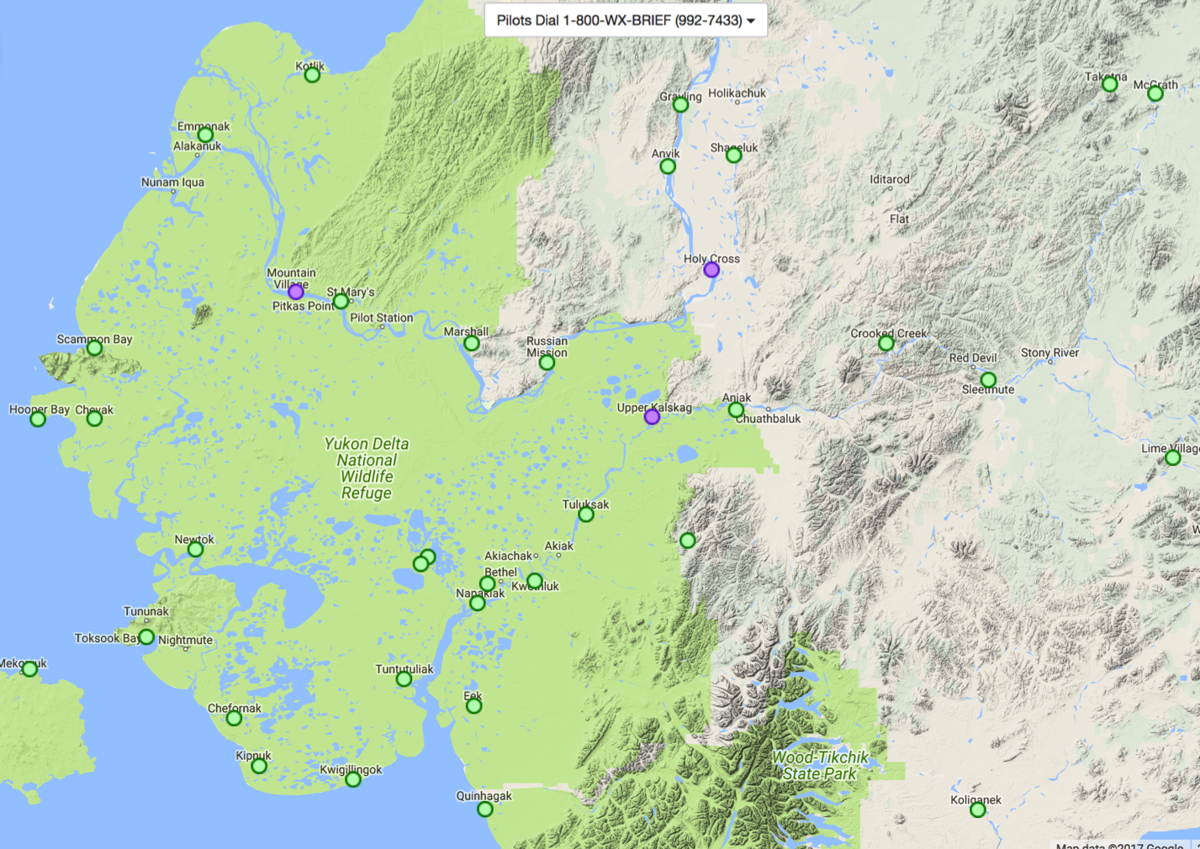
7 July 2017/DOY 188
Yukon-Kuskokwim Delta
FAA AVCAMS in the
YK Delta & Surrounding Areas

